Slide 1

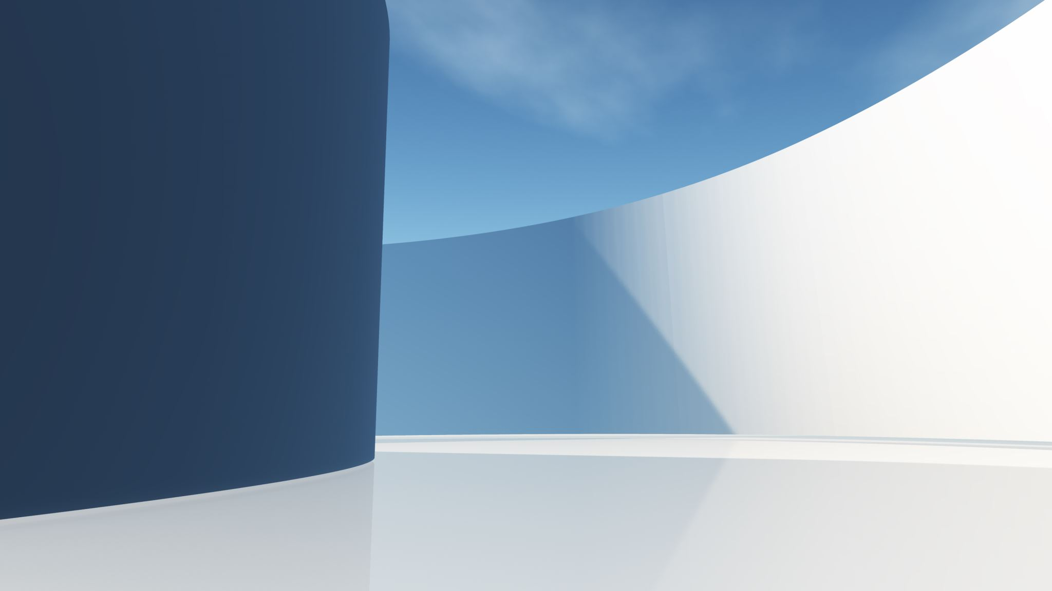


React Server Component

Slide 2

OUTLINE
1
Overview
2
Compare RSC & SSR
3
Features
4
Demo
5
Wrapping up

Slide 3




1
Overview

Slide 4

Why Server Component ?
Common Problems with React Applications:
User Experience: We build software products for our users and customers. The user experience of the application matters if we want the app to be successful.
Maintainability: The project code must be well maintained over the years, across several development teams.
Performance Cost: The application shouldn't be sluggish and our design approach must not slow things down.
Notes:
User Experience: Chúng tôi xây dựng các sản phẩm phần mềm cho người dùng và khách hàng của mình. Trải nghiệm người dùng của ứng dụng rất quan trọng nếu chúng ta muốn ứng dụng thành công.
Maintainability: Mã dự án phải được duy trì tốt qua nhiều năm, qua nhiều nhóm phát triển.
Performance Cost: Ứng dụng không được chậm và phương pháp thiết kế của chúng tôi không được làm mọi thứ chậm lại.

Slide 5
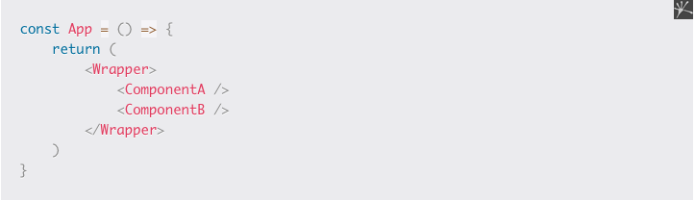
Why Server Component ?
Waterfalls networking
An example:

Slide 6
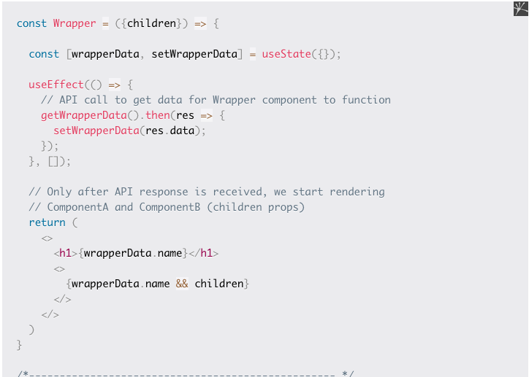
Why Server Component ?

Slide 7
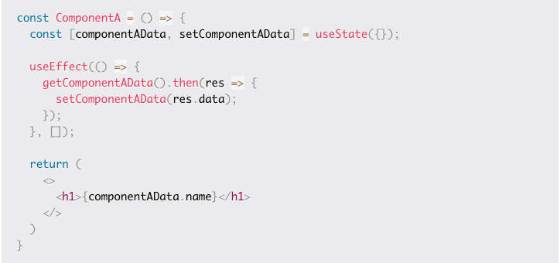
Why Server Component ?

Slide 8
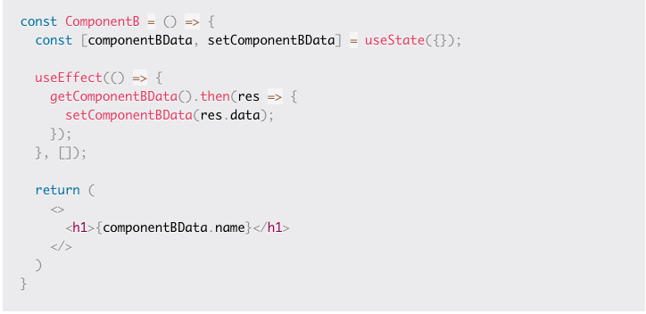
Why Server Component ?

Slide 9
Why Server Component ?
Assume the time it takes to get the response for API calls fired from each component is as follows:
<Wrapper /> takes 1 sec to get the response
<ComponentB /> takes 2 sec to get the response
<ComponentA /> takes 3 sec to get the response
The problem:
1. Wrapper is visible to the user after 1 sec.
2. Then ComponentB appears after 2 seconds.
3. After 3 seconds, ComponentA appears. But ComponentA enters the view by pushing ComponentB down. As if ComponentA just popped out of nowhere. This is not a great user experience.
Notes:
Waterfall problem
Another problem is, child components (ComponentA and ComponentB) are not even rendered until the Wrapper component get the response from the API call it made (refer to image 2), which results in a waterfall. Sequential data fetching always introduces waterfalls.
In our example, only after getting the response to the API call in the Wrapper component are the other two components rendered.
How can we solve this problem? Well, we can do a single fetch to get all the data in the App component, and then pass the necessary data to each component. Something like this:

Slide 10
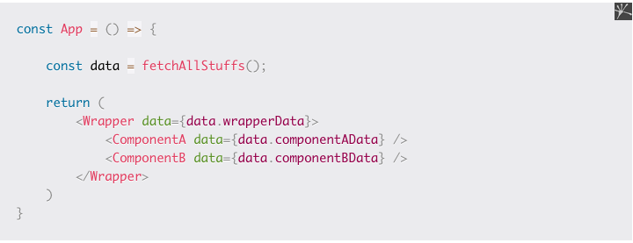
Why Server Component ?
Maintainability Issues
- For example, if we remove ComponentA in the future, we also want to remove componentAData from the API response, since we dont wan't to deal with data not used by the component. After all, if there's no ComponentA, then there's no need of ComponentAData.
Notes:
For example, if we remove ComponentA in the future, we also want to remove componentAData from the API response, since we dont wan't to deal with data not used by the component. After all, if there's no ComponentA, then there's no need of ComponentAData.
=> Maintainability Issues

Slide 11

Why Server Component ?
Performance Costs
- Traditionally, React components are client side JavaScript functions.
- When we load the application on the client, the components get downloaded on the client and React performs what's necessary to render them for you.

Slide 12


The solution is
Server Component
Example code…
Explain…

Slide 13

2
Compare
RSC & SSR

Slide 14
Different of 3 techniques
T2
T3
T3

Slide 15

3
Features

Slide 16


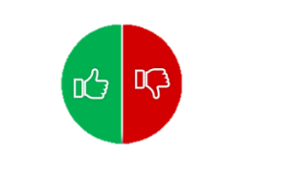
3.1 Do and Don’t of React Server Component
Do
Don’t
Content
Content
Content
Content
Content
Content
Content
Content

Slide 17



3.2 Zero bundle size components
Content…

Slide 18

3.3 Complete access to backend

Slide 19

3.4 Automatic
code
spitting
Content…

Slide 20
3.5 No more waterfall

Slide 21
4
Demo

Slide 22
5
Wrapping up

Slide 23
Thanks for watching!

